Slide 1
Mount House School Baking Booklet Lent Term 1

Slide 2
DATES
Week 1: Sausage Rolls (w/c 06.01.2025)
Week 2: Red Velvet Brownies (w/c 13.01.2025)
Week 3: Shortbread Biscuits (w/c 20.01.2025)
Week 4: Peach Melba Pop Pies (w/c 27.01.2025)
Week 5: Apple Puff Tart (w/c 03.02.2025)
Week 6: Raspberry lemonade scones recipe (w/c 10.02.2025)

Slide 3
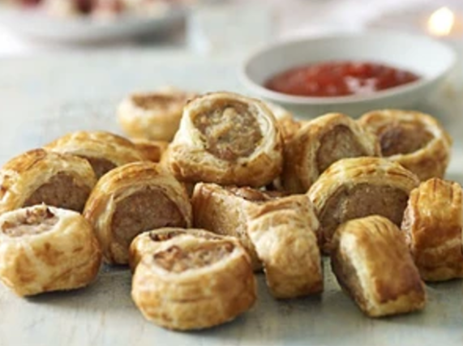
Week 1 Sausage Rolls
Ingredients
400g sausage meat
Chutney of choice (optional)
375g pack ready-rolled puff pastry
1 beaten egg
Vegetarian rolls can be made by replacing the sausage meat
with vegetarian style sausage meat

Slide 4
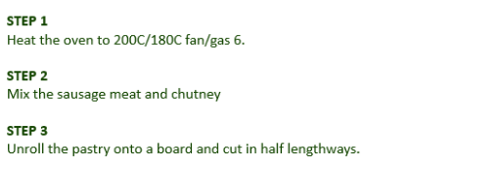
Instructions

Slide 5
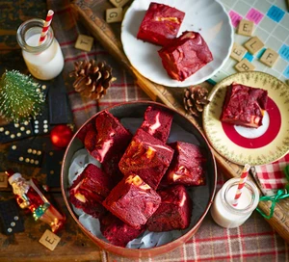
Week 2 Red Velvet Brownies
INGREDIENTS
170g salted butter, melted, plus extra for the tin
225g caster sugar
2 tsp vanilla extract (school to provide)
1 tsp red food colouring gel (school to provide)
3 eggs
40g cocoa powder
110g plain flour
1 tsp white wine vinegar (school to provide)
For the cheesecake swirl
250g soft cheese
1 egg yolk
3 tbsp caster sugar

Slide 6
Method
STEP 1
Butter a 20cm square brownie tin and line with baking parchment. Heat the oven to 180C/160C fan/gas 4.
STEP 2
Whisk the melted butter and sugar with the vanilla extract in a bowl. Once combined, whisk in the food colouring and eggs until the mixture is a vibrant red.
STEP 3
Sift in the cocoa powder and flour and add the vinegar. Fold together using a spatula.
For the cheesecake swirl, mix the soft cheese, egg yolk and sugar together and set aside.
STEP 4
Pour most of the brownie batter into the tin and dollop in the cheesecake mixture.
Pour the rest of the brownie batter on top and use a fork to lightly swirl the two together.
Bake for 30 mins until shiny on top.
Remove from the oven and cool in the tin.

Slide 7
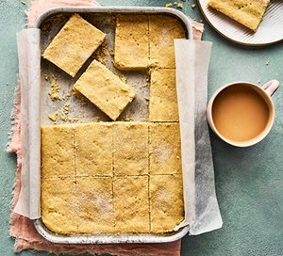
Week 3 Shortbread Biscuits
INGREDIENTS
250g unsalted butter, softened, plus extra for the tin
350g plain flour
50g rice flour
100g caster sugar, plus 1 tbsp

Slide 8
Method
STEP 1
Heat the oven to 180C/160C fan/gas 4. Butter and line a 28 x 18cm tin.
Mix together the butter, both flours, ½ tsp salt and the 100g of sugar until the mixture resembles fine breadcrumbs.
Continue to mix until it comes together into a rough ball.
Press the dough down into the tin and using a knife mark the dough into 16 bars.
STEP 2
Sprinkle over the remaining sugar and bake for 25-30 mins until golden and set.
Remove from the oven and allow to cool.

Slide 9
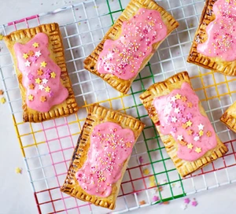
Week 4 Peach Melba Pop Pies
INGREDIENTS
200g raspberries
410g can peach slices in fruit juice, drained and chopped
1 tbsp cornflour (school to provide)
1 tbsp honey (school to provide)
2 x 320g shortcrust pastry sheet
1 egg, beaten
150g icing sugar
freeze-dried raspberries or sprinkles (optional)

Slide 10
Method
STEP 1
Heat oven to 200C/180C fan/gas 6.
Set 6 plump raspberries aside and tip the rest into a bowl. Add the peaches and toss together. In a small bowl mix the cornflour and honey to make a paste, pour over the fruit and combine.
STEP 2
Unroll the pastry sheets and cut out 6 rectangles from each one. Turn a piece of pastry so the long side is nearest to you, and fold it in half like a book, to create a fold down the middle.
Open the pastry out and spoon the fruit filling onto one side, leaving a border of about 1cm around the edge. Brush the beaten egg around the edges and fold the pastry again to encase the filling. Use a fork to seal the edges all the way around, then brush all over with more egg.
Poke a few air holes in the top with the fork. Repeat with the remaining pastry and filling.
STEP 3
Bake the pop pies for 20 mins, or until the pastry is golden and the filling is bubbling through the holes. Remove from the oven and allow to cool.

Slide 11
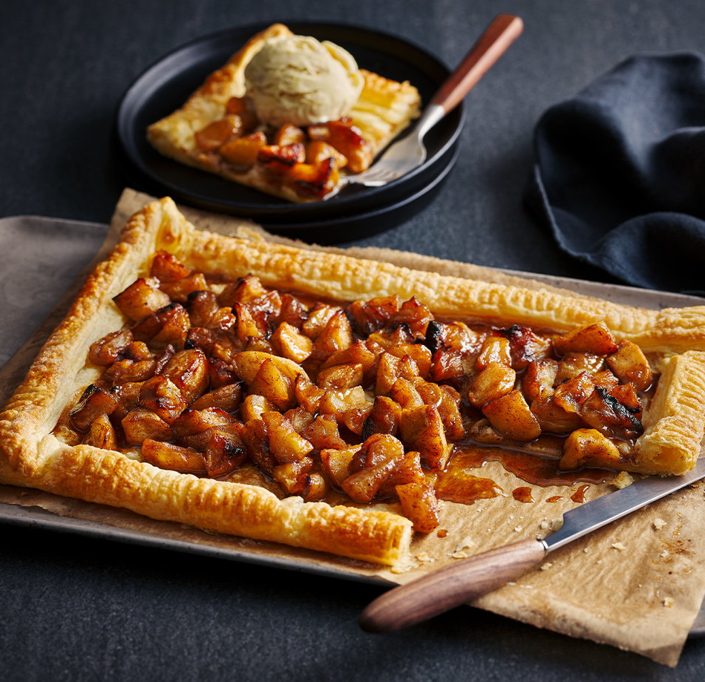
Week 5 Apple Puff Tart
INGREDIENTS
6 apples
½ lemon
2½ tbsp light brown sugar
1 tsp ground cinnamon (school to provide)
½ tsp ground nutmeg (school to provide)
1½ tbsp butter
½ tsp salt (school to provide)
375g pack ready-rolled puff pastry
2 tsp caster sugar

Slide 12
Instructions/Method
​STEP 1
Preheat the oven to gas 7, 220°C, fan 200°C. Line a roasting tin with baking paper.
STEP2
Peel the apples and place in a bowl of water with the lemon squeezed into it, to stop the apples from browning. Core and chop the apples into chunks and return to the lemon water.
STEP 3
Drain the apples and return to the bowl with the brown sugar and spices; toss together well.
STEP 4
Heat 1 tbsp of the butter in a frying pan and sprinkle in the salt.
STEP 5
Pour in the apples and cook over a gentle heat for 6-8 mins, stirring occasionally.
STEP 6
Roll out the pastry and fold all the edges in, roughly 2cm. Using a fork, press all around the edges to make a nice pattern. Spread with the remaining butter and sprinkle with the caster sugar. Place the pastry in the prepared tin.
STEP 7
Spoon the apples over the centre of the pastry, leaving the folded edges clear. Reserve the liquid in the frying pan.
STEP 8
Bake the tart for 22-25 minutes until the edges are risen and golden. Remove the cooked tart from the oven and leave to cool for 5 mins before drizzling with the leftover juices in the pan.

Slide 13
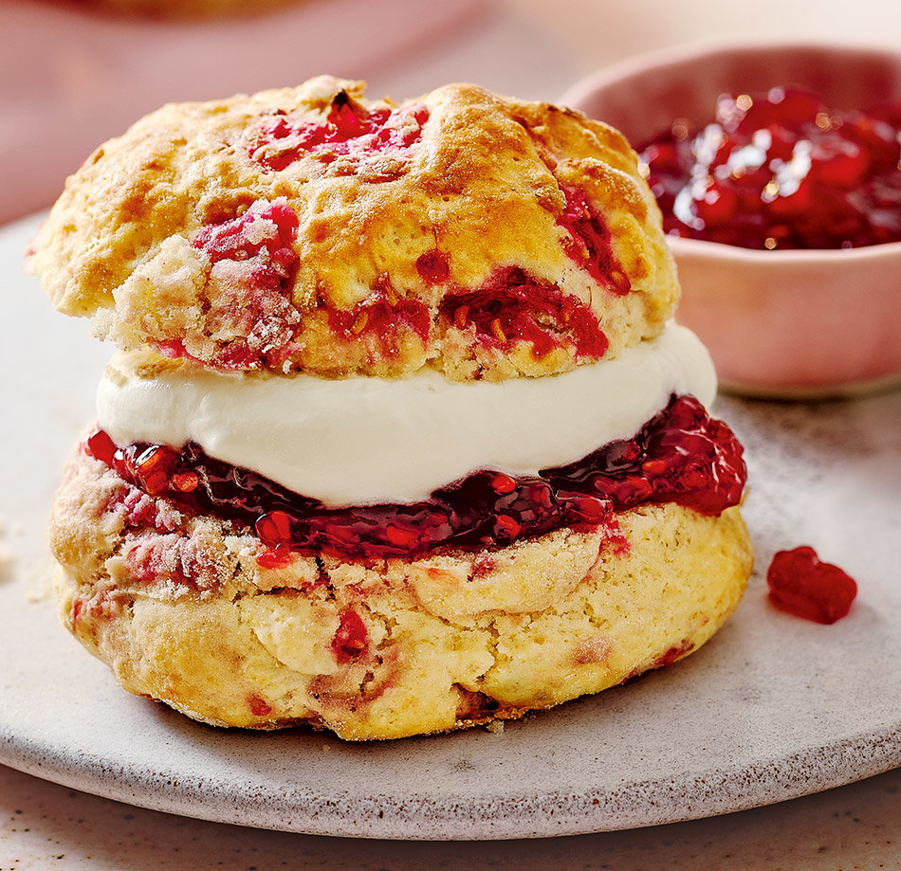
Raspberry lemonade scones recipe
Week 6
INGREDIENTS
300g self-raising flour, plus extra for dusting
50g caster sugar
125ml pink lemonade, plus 2 tsp
150ml whipping cream, plus extra to serve (optional)
100g frozen raspberries
raspberry jam, to serve (optional)

Slide 14
Instructions/Method
STEP 1
Put the flour, sugar and ¼ tsp salt in a large mixing bowl. Mix the lemonade with 125ml cream in a jug, then pour over the dry ingredients and use a cutlery knife to mix to a soft, crumbly dough. Preheat the oven to gas 7, 220°C, fan 200°C and lightly dust a baking sheet with flour.
STEP 2
Tip the dough onto a lightly floured surface, scatter over the frozen raspberries and knead lightly until combined and the raspberries are evenly rippled through.
STEP 3
Use your hands or a rolling pin to pat or roll the dough to a thickness of 3cm, then use a 5cm round cutter, dipped in flour, to cut out scones. Reroll the trimmings to make 8 scones. Mix 1 tbsp cream with 2 tsp lemonade to loosen, then use to brush the tops of the scones. Bake for 12-14 mins until risen and lightly browned.
STEP 4
To serve, split the warm scones and top with whipped cream and raspberry jam, if you like.

