Slide 1
Mount House School Baking Booklet Spring Term 2

Slide 2
DATES
Week 1: lemon school cake (w/c 24.02.2025)
Week 2: pancakes (w/c 03.03.2025)
Week 3: chocolate fairy cakes (w/c 10.03.2025)
Week 4: shortbread biscuits (w/c 17.03.2025)
Week 5: Easter bunny lemon cakes (24.03.2025)
Week 6: Easter tray bake (31.03.2025)

Slide 3
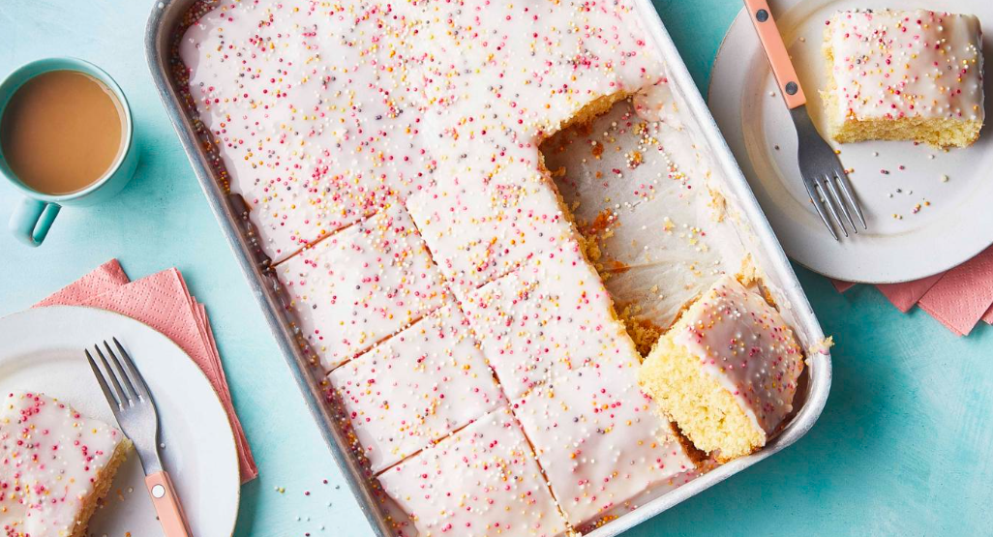
Ingredients
225g/8oz butter, softened, plus extra for greasing
225g/8oz caster sugar
250g/9oz self-raising flour
4 free-range eggs
3 tbsp milk (school to provide)
2 lemons, finely grated zest and juice
pinch salt
200g/7oz-300g/10½oz icing sugar
multi-coloured sprinkles, to decorate

Slide 4
Method
STEP 1
Preheat the oven to 180C/160C Fan/Gas 4. Grease and line the bottom of a roughly 26x22cm/10½x8½in baking tin.
STEP 2
Using an electric whisk, beat together the butter, caster sugar, flour, eggs, milk, lemon zest and salt in a large bowl until smooth and creamy.
STEP 3
Spread the mixture in the tin, levelling off the surface with the back of a spoon.
STEP 4
Bake for 25–30 minutes until golden and springy. Leave to cool in the tin for a few minutes then carefully remove the paper and leave to cool completely on a wire rack.
STEP 5
Mix together the icing sugar and enough lemon juice to make a pourable icing.
STEP 6
Spread the icing over the cooled cake, scatter over some sprinkles and leave to set before cutting into squares.

Slide 5
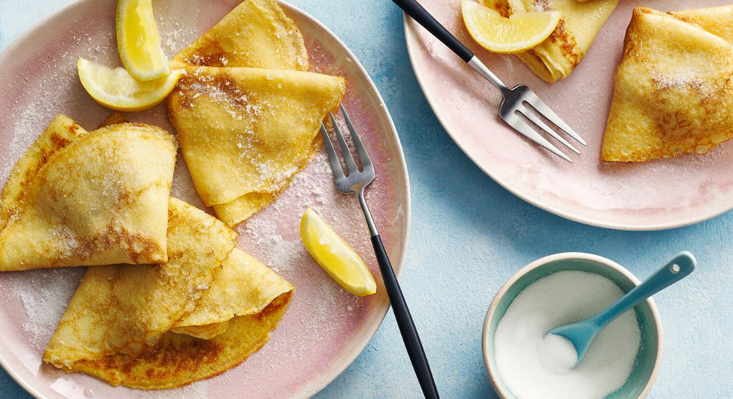
For the pancake mixture
110g/4oz plain flour, sifted
pinch of salt (school to provide)
2 eggs
200ml/7fl oz milk mixed with 75ml/3fl oz water
50g/2oz butter
Bring toppings of your choice (no nuts)

Slide 6
Method
STEP 1
Sift the flour and salt into a large mixing bowl with a sieve held high above the bowl so the flour gets an airing.
STEP 2
Now make a well in the centre of the flour and break the eggs into it. Then begin whisking the eggs – any sort of whisk or even a fork will do – incorporating any bits of flour from around the edge of the bowl as you do so.
STEP 3
Next gradually add small quantities of the milk and water mixture, still whisking (don't worry about any lumps as they will eventually disappear as you whisk).
STEP 4
When all the liquid has been added, use a rubber spatula to scrape any elusive bits of flour from around the edge into the centre, then whisk once more until the batter is smooth, with the consistency of thin cream.
STEP 5
Now melt the 50g/2oz of butter in a pan.
STEP 6
Ensure the pan is hot and pour mixture in.
STEP 7
As soon as the batter hits the hot pan, tip it around from side to side to get the base evenly coated with batter. It should take only half a minute or so to cook; you can lift the edge with a palette knife to see if it's tinged gold as it should be.

Slide 7
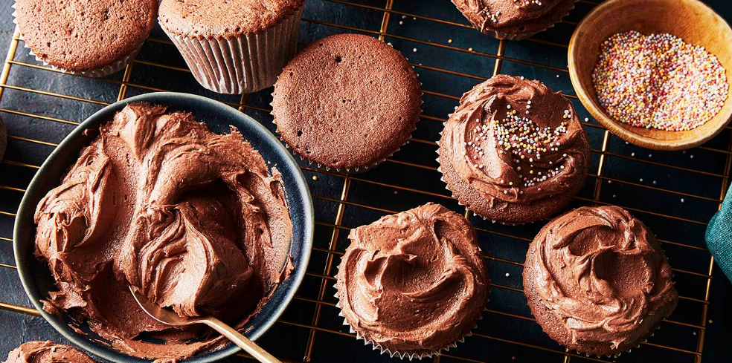
Ingredients
For the cakes
175g/6oz margarine suitable for baking
175g/6oz caster sugar
3 large free-range eggs
2 tbsp full-fat milk (school to provide)
25g/1oz cocoa powder (school to provide)
150g/5½oz plain flour
2 tsp baking powder (school to provide)
For the buttercream icing
175g/6oz butter, softened
300g/10½oz icing sugar, sifted
4 tbsp cocoa powder (school to provide)
2 tsp vanilla extract (school to provide)
1 tbsp milk, plus extra if needed (school to provide)
sprinkles, to decorate (optional)

Slide 8
Method
STEP 1
To make the cakes, preheat the oven to 180C/160C Fan/Gas 4. Place 12 fairy cake liners in a cupcake tin.
STEP 2
Whisk the baking spread and caster sugar in a stand mixer or in a bowl with a handheld mixer for about 5 minutes, or until fluffy. Add the eggs and milk and whisk again. Add the cocoa, flour and baking powder and whisk for 1 minute.
STEP 3
Divide the mixture evenly between the cupcake liners. Bake for 25 minutes or until a skewer comes out clean. Transfer to a wire rack to cool.
STEP 4
To make the buttercream, beat the butter for 1 minute. Add the icing sugar, cocoa, vanilla and milk. Beat for about 3–4 minutes or until smooth. If the mixture is too thick, add another tablespoon of milk.
STEP 5
Scrape the buttercream into a piping bag to decorate or use a palette knife to spread over the cakes. Decorate with some sprinkles if preferred.

Slide 9
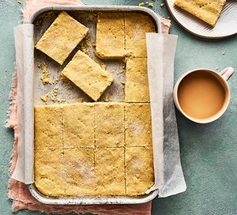
INGREDIENTS
250g unsalted butter, softened, plus extra for the tin
350g plain flour
50g rice flour
100g caster sugar, plus 1 tbsp

Slide 10
Method
STEP 1
Heat the oven to 180C/160C fan/gas 4. Butter and line a 28 x 18cm tin.
Mix together the butter, both flours, ½ tsp salt and the 100g of sugar until the mixture resembles fine breadcrumbs.
Continue to mix until it comes together into a rough ball.
Press the dough down into the tin and using a knife mark the dough into 16 bars.
STEP 2
Sprinkle over the remaining sugar and bake for 25-30 mins until golden and set.
Remove from the oven and allow to cool.

Slide 11
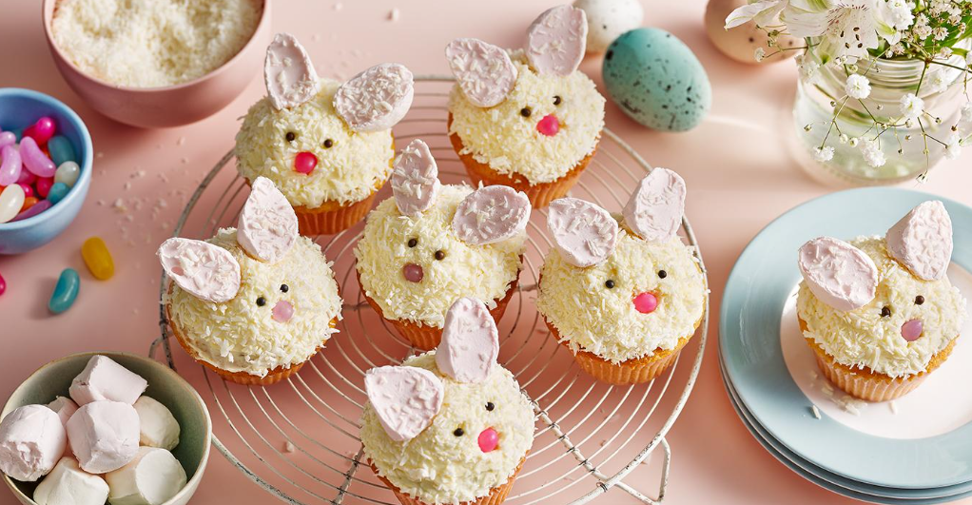
Ingredients
For the cupcakes
200g/7oz unsalted butter, softened
200g/7oz caster sugar
1 lemon, finely grated zest only
3 large free-range eggs
200g/7oz plain flour
2 tsp baking powder (school to provide)
pinch salt (school to provide)
3 tbsp milk (school to provide)
For the buttercream
200g/7oz unsalted butter, softened
1 lemon, finely grated zest only
320g/11½oz icing sugar
2 tbsp fresh lemon juice
For the topping
150g/5½oz desiccated coconut
12 large marshmallows
black sugar pearls, for the eyes (optional)
pink jelly beans, for the noses (optional)

Slide 12
Method
STEP 1: Preheat the oven to 180C/160C Fan/Gas 4. Line a 12-hole cupcake tin with paper cases.
STEP 2: To make the cupcakes, beat the butter, sugar and lemon zest together - whisk for 3–5 minutes until very pale and fluffy.
STEP 3: Add the eggs in one at a time, beating the mixture well after each one.
STEP 4: In a separate bowl, sift together the flour, baking powder and salt. Pour this into the butter mixture and mix on a low speed until smooth before stirring in the milk.
STEP 5: Scoop the mixture evenly into the cupcake cases and bake for 20–25 minutes until golden and well risen. Remove from the oven and leave to cool completely.
STEP 6: To make the buttercream, beat the butter and lemon zest
STEP 7: Sift in the icing sugar and beat until the buttercream is thick and fluffy. Pour in the lemon juice and beat for another few seconds to combine.
STEP 8: To assemble, pour the desiccated coconut into a shallow bowl. Spoon or pipe some buttercream onto each cupcake. Dip the cupcakes buttercream-side down into the coconut, making sure it is fully covered.
STEP 9: To make the bunny ears, use a pair of scissors to cut the marshmallows in half diagonally. Dip the sides of the marshmallows that have been cut into the desiccated coconut and place them on the cupcakes side-by-side so they look like bunny ears. Use the black sugar pearls and jelly beans to form the eyes and noses (if using).

Slide 13
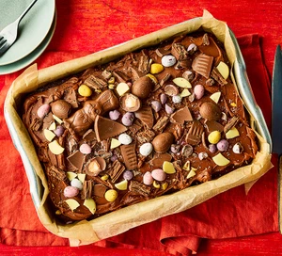
INGREDIENTS
150ml sunflower oil, plus extra for the tin
165g golden caster sugar
2 eggs
150ml milk
165g self-raising flour
3 tbsp cocoa powder (school to provide)
1 tsp bicarbonate of soda (school to provide)
For the chocolate fudge icing
100g milk or dark chocolate, chopped
100g butter
100g icing sugar
100g Easter treats (chocolate eggs, sweets, chocolate bar pieces)

Slide 14
METHOD
STEP 1
Heat the oven to 180C/160C fan/gas 4.
Line a traybake tin, about 20 x 30cm, and 5cm deep.
Put the oil, sugar, eggs and milk in a bowl and whisk until well combined.
Sieve over the flour, cocoa and bicarb, and stir briefly until combined.
Pour the mixture into the tin and bake for 20-25 mins until the cake is well risen and springs back when pressed. Transfer to a wire rack and leave to cool completely.
STEP 2
Melt the chocolate in a bowl and leave to cool for a few minutes.
STEP 3
Beat the butter and icing sugar together until pale and fluffy, then drizzle in the chocolate and beat again until smooth and uniform in colour. Swirl the icing over the top of the cake, with a few peaks and swirls to decorate. Scatter with the Easter treats to serve.

